Slide 1
PARTS OF SPEECH

Slide 2
Introduction
Parts of speech denotes a term in a language that describes the classification of words according to their purpose within a sentence.
Understanding parts of speech provides the ability to study sentences and understand them.
It also helps in understanding grammar and correct use of the language.
Part of speech examples include nouns, verbs, adjectives, pronouns, adverbs, conjunctions, prepositions, interjections, etc.
We are going to learn about parts of speech through a short story about two little girls, Joy and Lily.

Slide 3
Chapter 1: Nouns
Nouns are names of things, people, places, concepts and animals, for example, boy, cat, house, book, market.
When the name in a sentence is the official name of someone or something, it is called a proper noun and we capitalize it, for example Christopher, Florida.
In the following sentence, the words in bold are nouns;
Joy and Lily are friends. They both live with their parents in their neighboring homes.

Slide 4
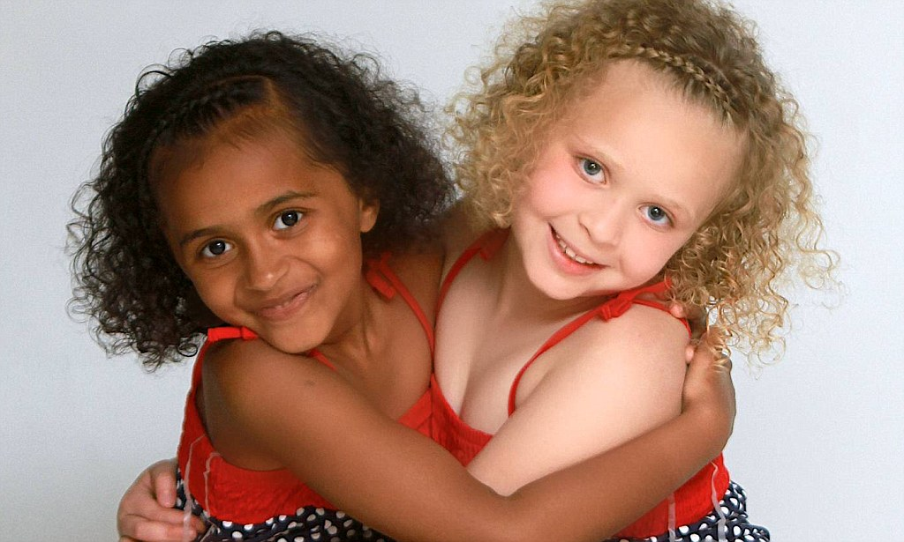
Chapter 2: Adjectives
Adjectives are words that modify nouns or pronouns in a sentence by quantifying, describing or identifying them, including cold, red, many, beautiful.
There is no plural for adjective words in English.
Adjectives can be possessive ("my", "our", "your", "his", "her", "them"), interrogative ("which", "what"), demonstrative ("this", "that "," These "," those ") or indefinite (" many "," any "," all ").
Joy is African-American while Lily is white and they are both beautiful girls.

Slide 5
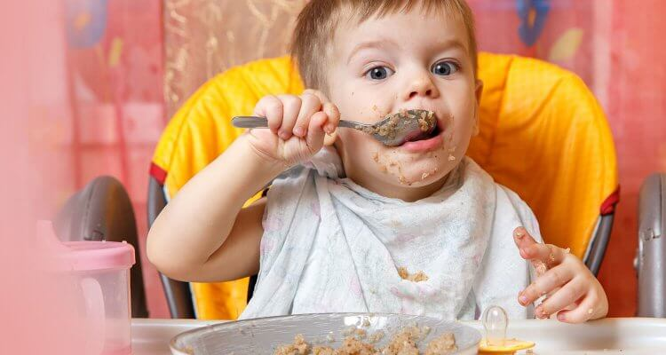
Chapter 3: Verbs
Verbs are words that communicate the action, state of need, being, preference or meaning of the noun in a sentence, including eat, sing, sitting, running, love, hate.
Verbs vary in tense, past, continuous or present (e.g. walk, walked, walking) and count features, singular or plural (e.g. walks, walk).
In the following sentence examples, the bold words represent verbs in two different forms:
Joy likes to tell stories, and Lily enjoys them. Lily’s white friends like to make fun of Joy because of how she looks.

Slide 6

Chapter 4: Prepositions
Prepositions are words that show the correlation between nouns or pronouns and other words in a sentence.
Prepositions can be simple, i.e. short words, single words, including up, into, under, on, at, or up to four words, including, out of, as a result of, against.
One day, while Joy and Lily were walking home from school, Joy tripped and fell down. Lily’s white friend saw her falling and laughed at her.

Slide 7
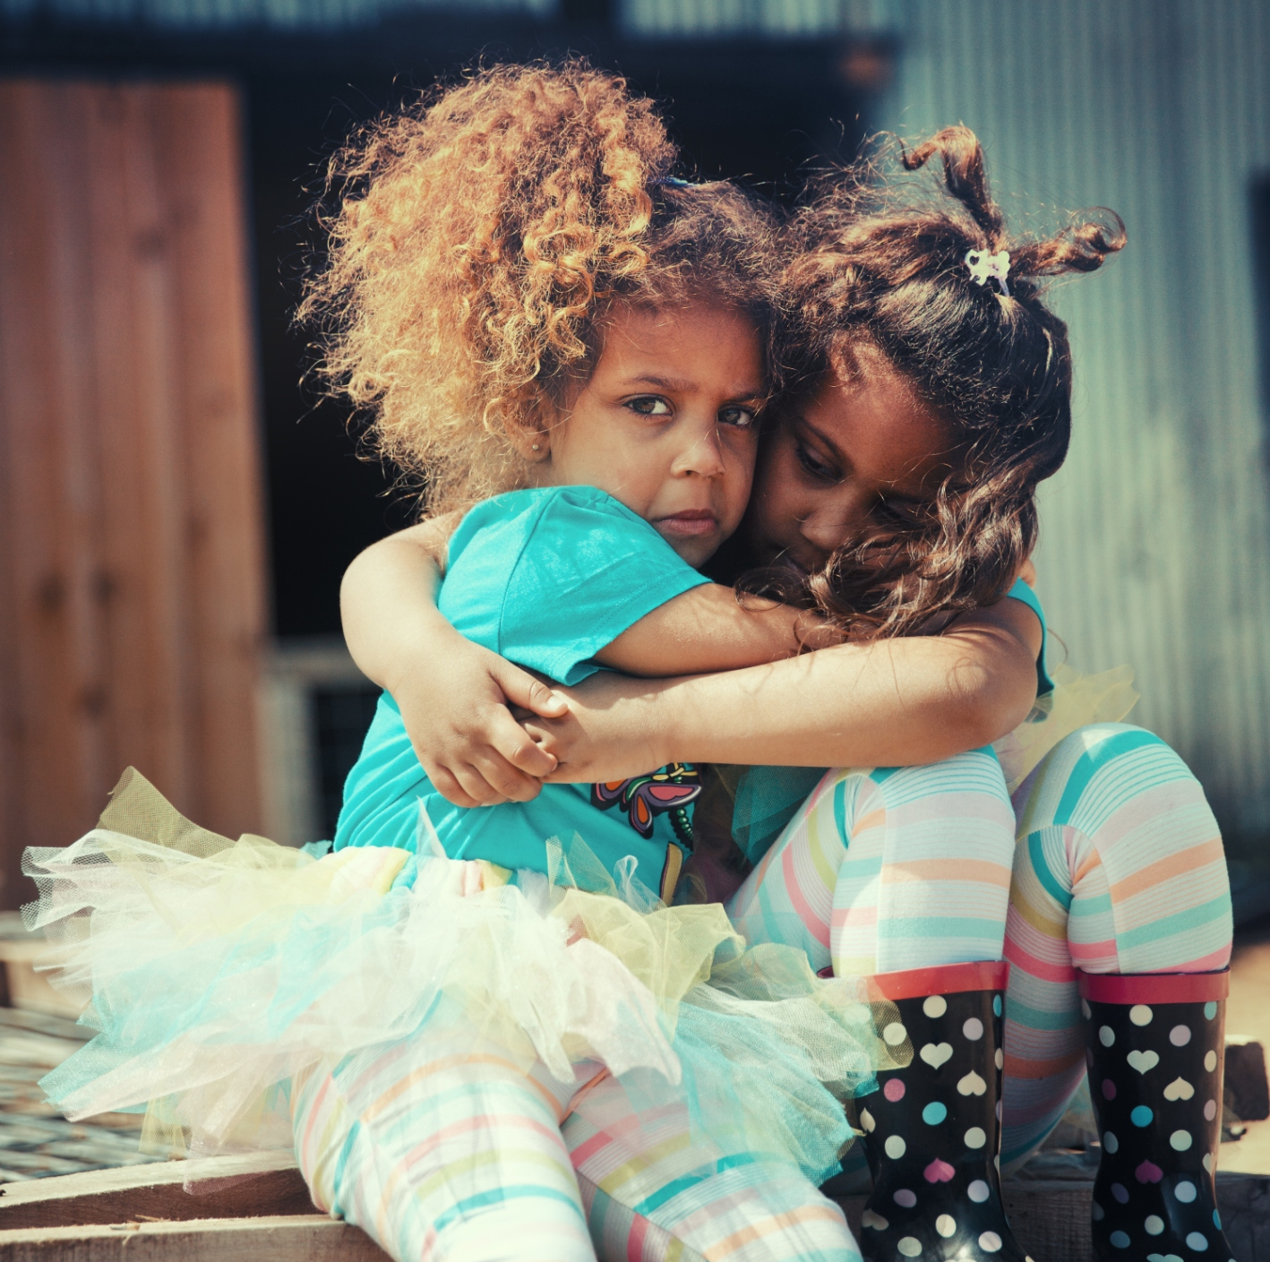
Chapter 5: Articulated and idiomatic prepositions
Articulated prepositions refer to a combination of a simple article with the noun article following it.
Idiomatic prepositions are prepositions that can be combined with other words to form idioms; phrases whose implications are somewhat different from the exact implications of the words they are made of.
Lily was not happy with her friends. She helped Joy stand up, embraced her, and told her, “I’m sorry about my friends, and don’t cry. I am still your friend and I will stand by you regardless of their attitude towards you.”
stand by someone means being in their defense.

Slide 8
Chapter 6: Pronouns
Pronouns are words that substitute nouns or noun phrases in a sentence to avoid repetition, including me, you, her, him, them, none, some.
Examples in a sentence include; Our nanny is so nice. She is the best.
A demonstrative pronoun indicates a noun or a noun phrase as being near (this or these) or further away (that or those) in time and space.
"This" and "That" imply singular nouns or noun phrases while "These" and "Those" imply plural nouns and noun phrases.
Lily went to her friends and told them that it was wrong of them to laugh at Joy. She told them that she is a good friend and they would enjoy her company since she is a good story teller.

Slide 9
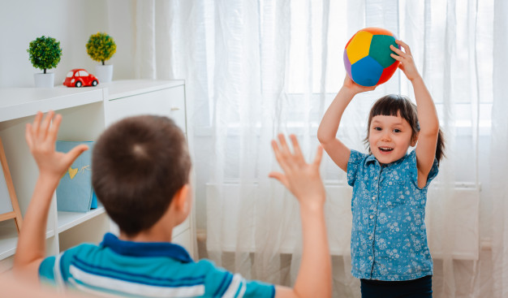
Interrogative Pronouns
Interrogative pronouns ask questions and include "what", "who", "whom", "what", "whomever", "whatever", and "whoever".
"Who" represents the verbal subject, while "whom" represents the verbal or prepositional object.
Examples in a sentence include;
Since then, Joy won their friendship through her funny stories, and they were always protective of her whenever any white person tried to make fun of her.
This short story teaches us that we should not discriminate others due to race, background, gender or other ways they may be different from us. The person we discriminate could have a talent that we can enjoy and learn from, like reading, singing, or telling stories.

